Slide 1
Oxirane Synthesis with Substituted Alkenes and Subsequent Reactions
2-vinylnaphthalene
Manoj and Patrick

Slide 2
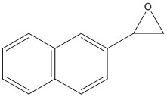
Synthesis of Oxirane
Started with 2-vinylnaphthalene
Procedure:
Dissolved alkene in dichloromethane
Added mCPBA, heated for 1 hour
Carried out Base Extractions
Finally used roto-vap machine

Slide 3
Results
First attempt: no oxirane acquired, temperature fluctuated during heating process of 1 hour
Second attempt: very little oxirane acquired, temperature was controlled and reaction proceeded for 2 hours
We attempted a another base extraction followed by a water extraction to eliminate any mCPBA by-product
Water extraction resulted in “pink-smoothie” solution

Slide 4
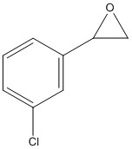
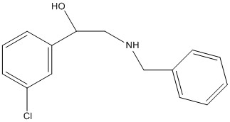
Synthesis of Amino Alcohol
Started with 3-chlorostyreneoxide
Procedure:
Combined equimolar amounts of oxirane and benzyl amine and let solution mix for ~1 week
Added boiling hexane and filtered solution
Used roto-vap machine and identified compound

Slide 5
Results
First Attempt: we had a viscous yellow solution which required a large amount of hexane, product potentially left on filter paper
Rinsed out of paper with dichloromethane and repeated procedure
This resulted in an orange colored solution
GCMS identified product as not being an Amino Alcohol

Slide 6
Results (cont.)
Second Attempt: Used smaller reaction container to ensure proper mixing of reactants
Used Ether to filter instead of hexane
GCMS identified product as not being an Amino Alcohol
GCMS data was identical to the product when hexane was used to filter

Slide 7
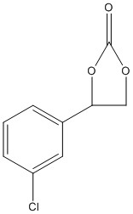
Synthesis of Carbonate
Started with 3-chlorostyreneoxide
Procedure:
Combined oxirane and dry ice (CO₂) in ball mill tube
Ran ball mill for ~16 hours
Identified product using IR

Slide 8
Results
First Attempt: no product, ran reaction again
Second Attempt: dilute product resulted but dilute carboxylate was present in IR
Dissolved product in ether and filtered using Pasteur pipette
Took IR again, dilute carboxylate still present

Slide 9
Future Experimentation for all Oxirane Procedures
Using alkenes with different functional groups to produce an oxirane – procedures may be unique for starting materials
Using different conditions and reagents when synthesizing amino alcohol and carbonate
Using different conditions to improve oxirane yield (i.e. heating period, new solvents)
Clean up aziridine
Methodology for removing excess benzylamine from amino alcohol (vacuum pump? Need to ask Dr. L)
New solvents (similar to ether but cannot dissolve triphenylphosphine oxide)

